Slide 1
Outlier Detection
Image: http://machinelearningmastery.com/wp-content/uploads/2013/12/outlier.jpg

Slide 2
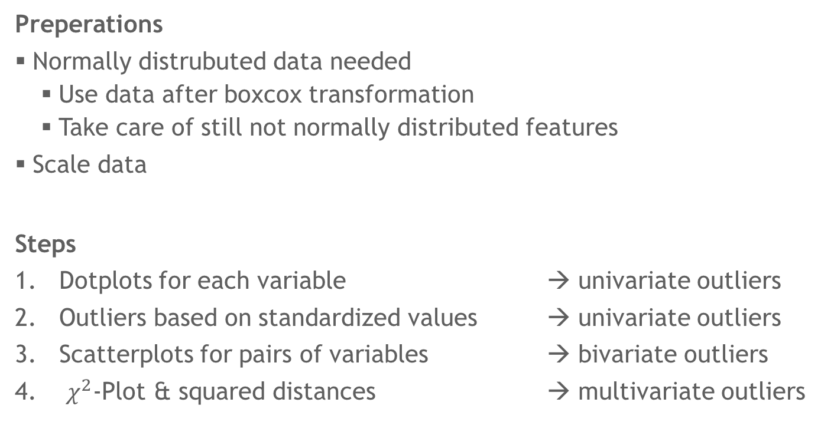
Outlier Detection
Overview
Preperations
Normally distrubuted data needed
Use data after boxcox transformation
Take care of still not normally distributed features
Scale data
Steps
Dotplots for each variable → univariate outliers
Outliers based on standardized values → univariate outliers
Scatterplots for pairs of variables → bivariate outliers
$χ^{2}$-Plot & squared distances → multivariate outliers

Slide 3
Outlier Detection
Univariate Outliers
Have a look at Boxplots first
Feature 12 of ela_local not normally distributed → ignore
Notes:
Determine max sigma value per row, exclude outliers with sigma > 4.5 (in contrast to 3.5 in lecture due to high number of rows)

Slide 4
Outlier Detection
Univariate Outliers
Determine univariate outliers by dotplots (max value per group)
92 univariate outliers

Slide 5
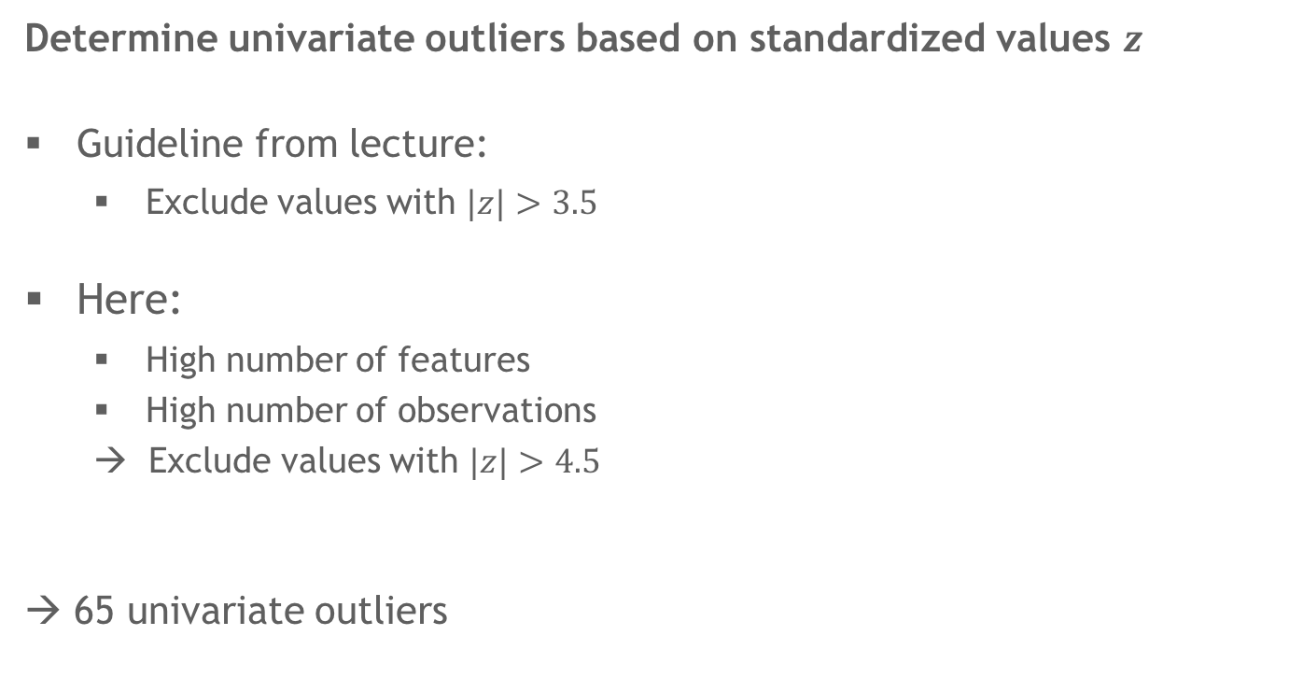
Outlier Detection
Univariate Outliers
Determine univariate outliers based on standardized values $z$
Guideline from lecture:
Exclude values with $|z|>3.5$
Here:
High number of features
High number of observations
→ Exclude values with $|z|>4.5$
→ 65 univariate outliers

Slide 6
Outlier Detection
Bivariate Outliers
Large number of dimensions
identify outliers within feature groups + between PCs of feature groups
6 outliers

Slide 7
Outlier Detection
Bivariate Outliers
Large number of dimensions
identify outliers within feature groups + between PCs of feature groups
17 outliers

Slide 8

Outlier Detection
Multivariate Outliers
Using $χ^{2}$-Plot to determine multivariate outliers
(whole dataset & per feature groups)
Exclude outliers by 0.001-quantile of $χ^{2}$-distribution → 125 outliers

Slide 9
Outlier Detection
Results
Focus on calculated values rather than outliers identified by plots
Univariate: 65
Multivariate: 125
Total: 190
→ 2810 observations left for further steps

